Slide 1
Challenge 2 Collecting, Saving, and Visualizing Data from the Physical World
Group 3
Aoshuang wang, lan yao, yixuan huang, lan luo

Slide 2
 | Lan Yao | Aoshuang Wang | Yixuan Huang | Lan Luo
Challenge 1 | Presenter
Challenge 2 |  |  | Presenter
Challenge 3
Challenge 4
Challenge 5
Challenge 6
Challenge 7
Challenge 8

Slide 3
 | Lan Yao | Aoshuang Wang | Yixuan Huang | Lan Luo
1 | Program Writing Realtime Plot | Program Writing Historical Plot | Hardware Setup Historical Plot | Hardware Setup Realtime Plot

Slide 4
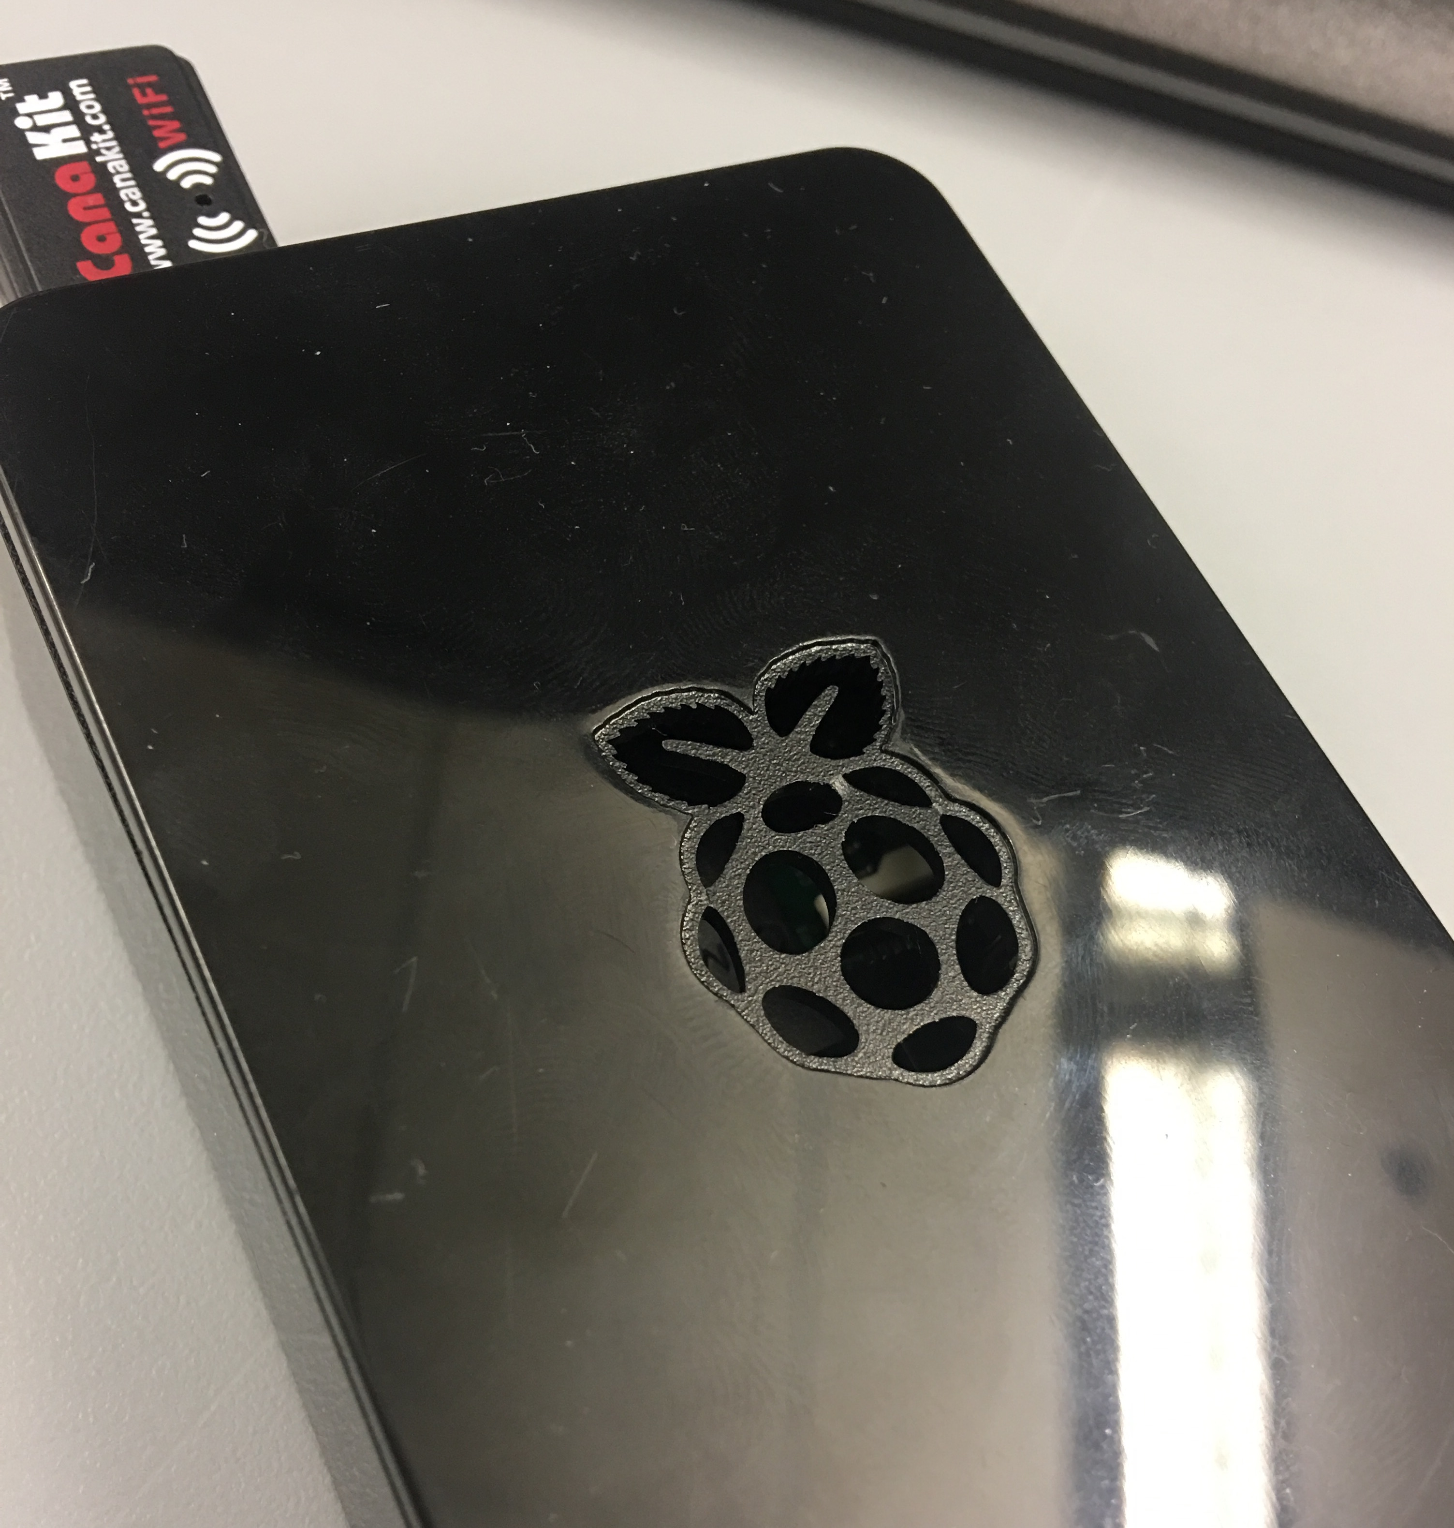

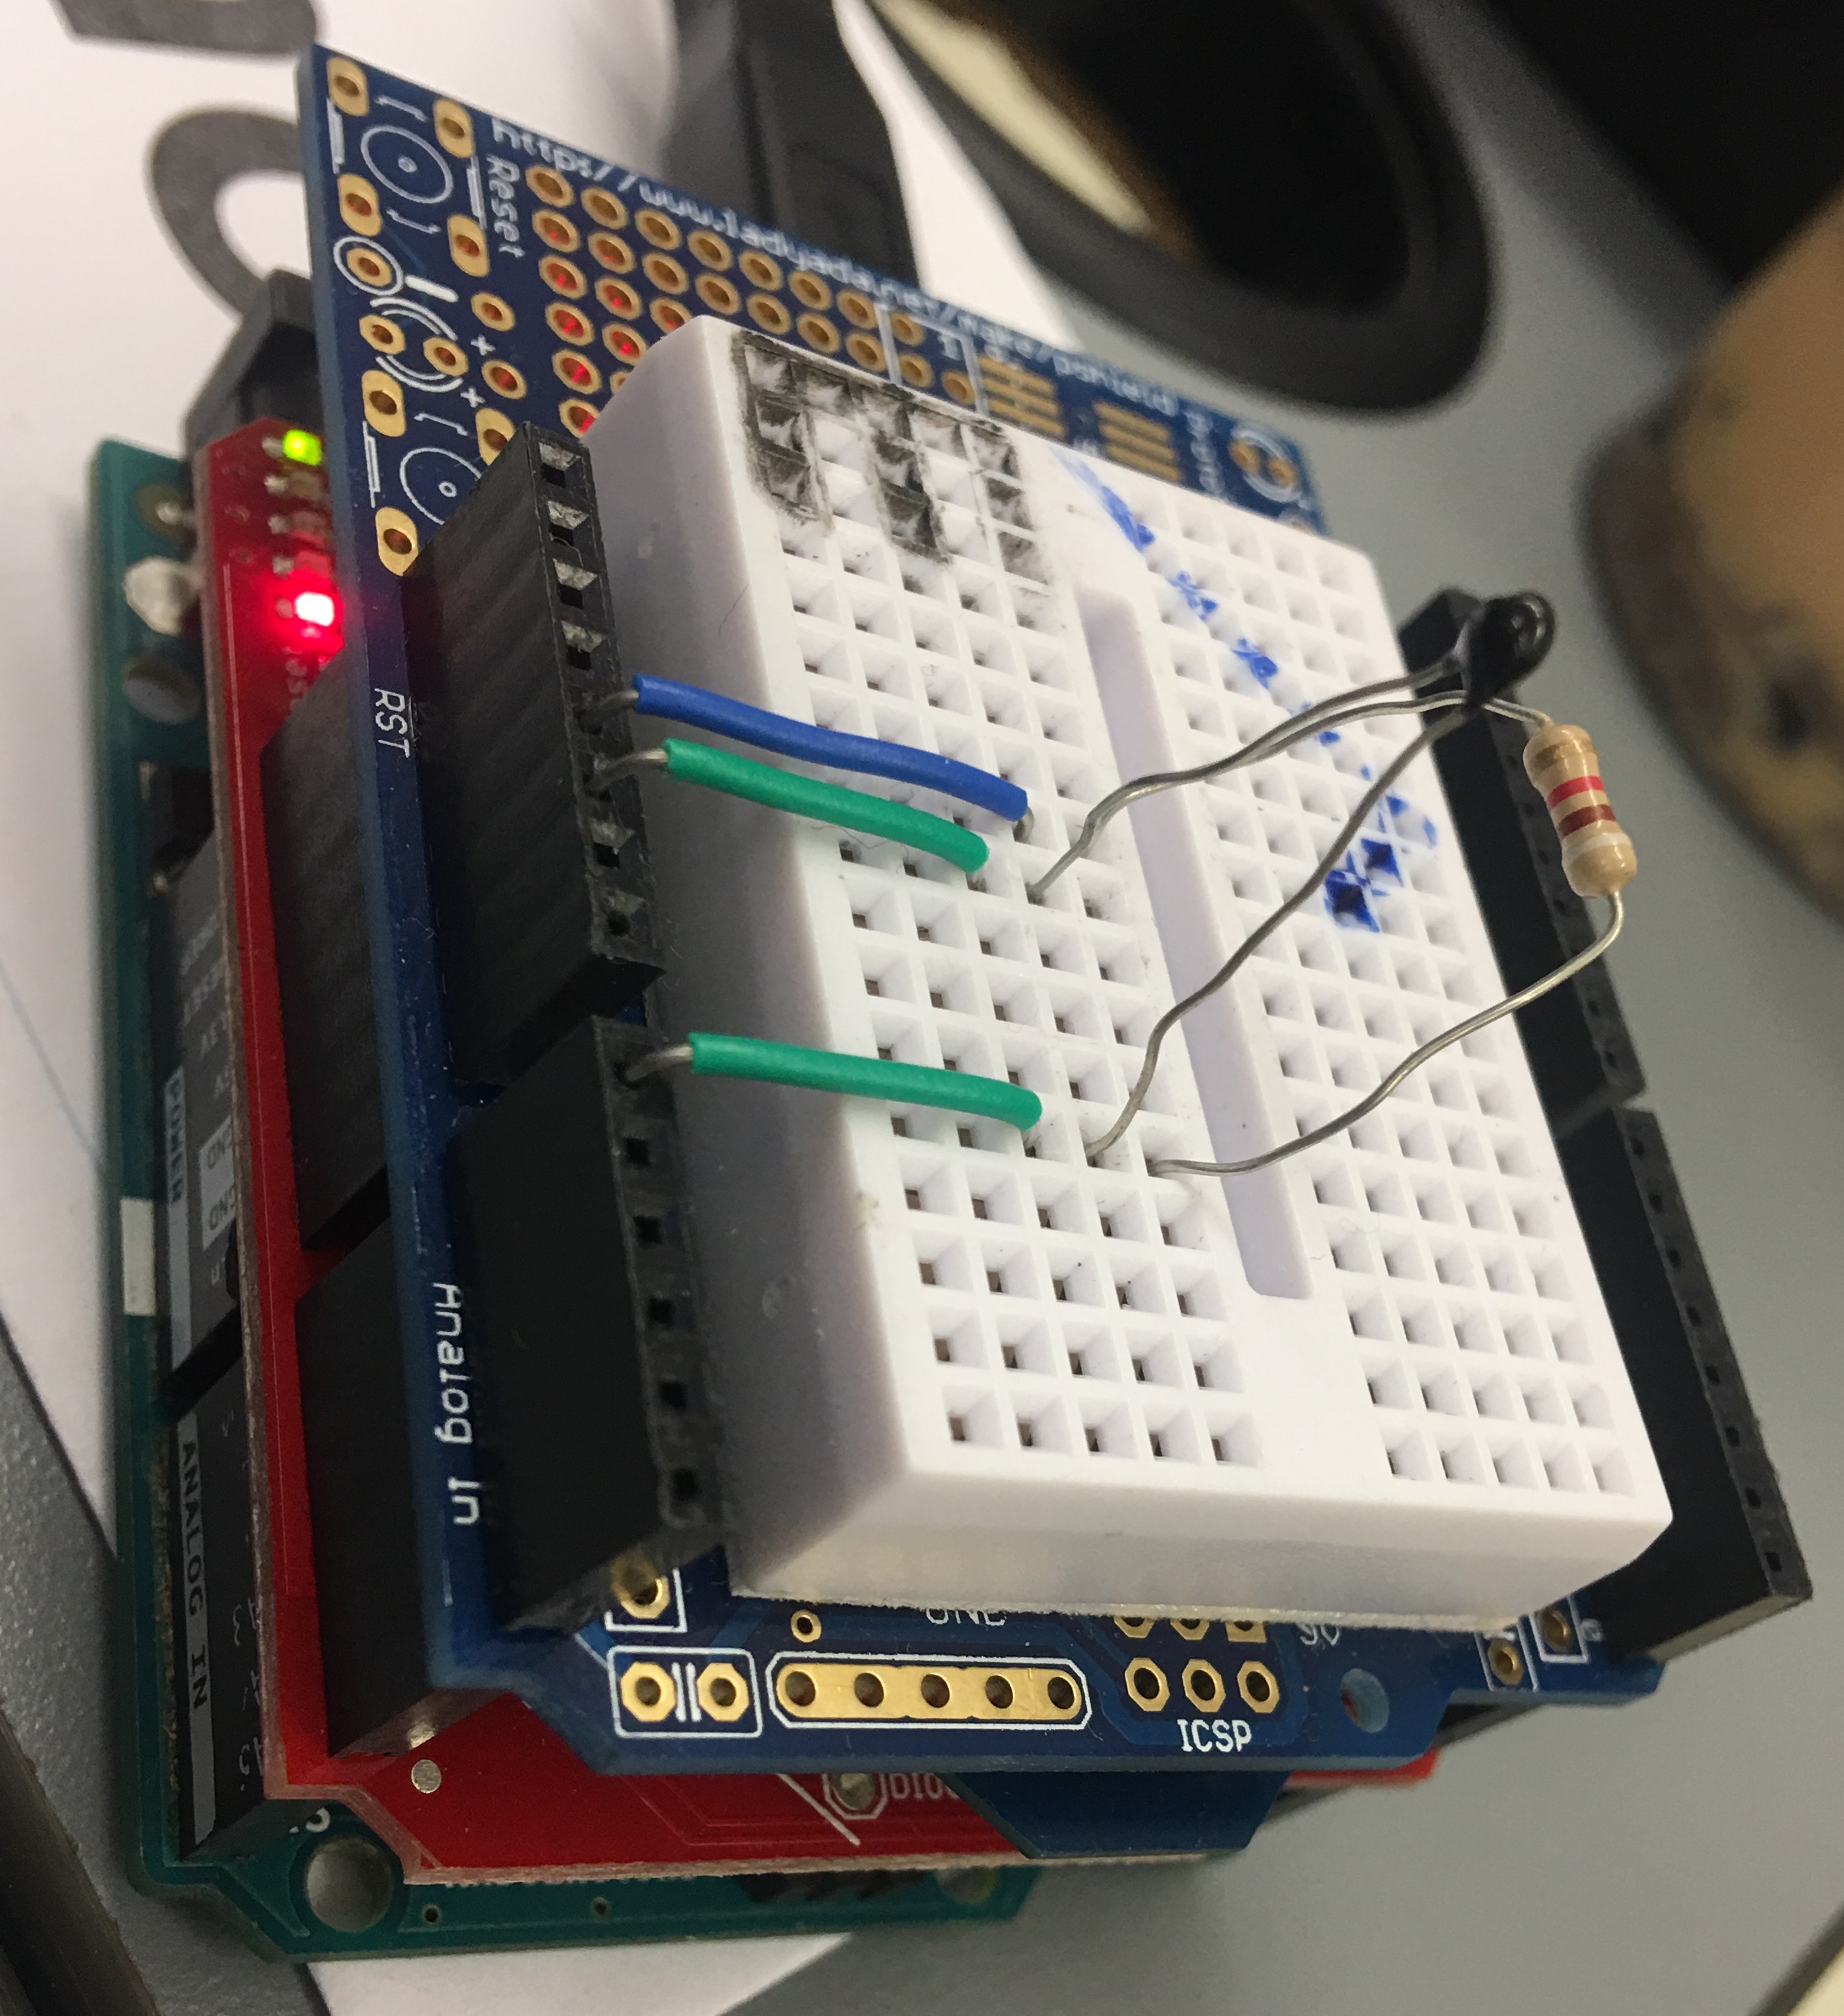
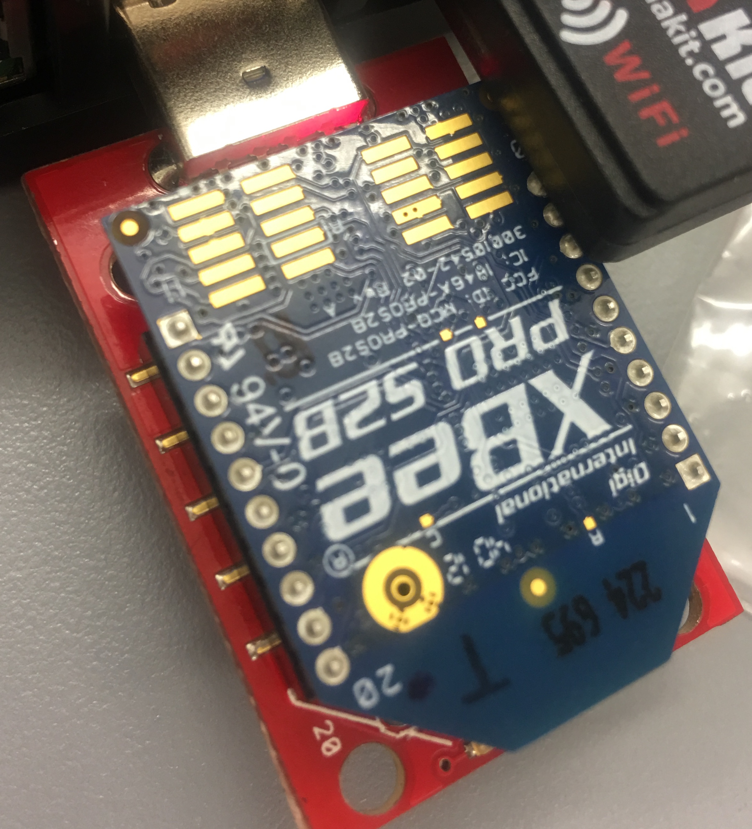
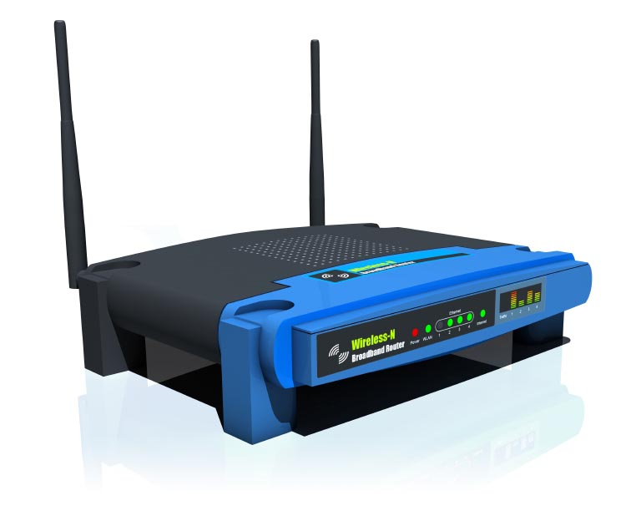
Devices
Raspberry Pi
Sensor
Router
Coordinator

Slide 5
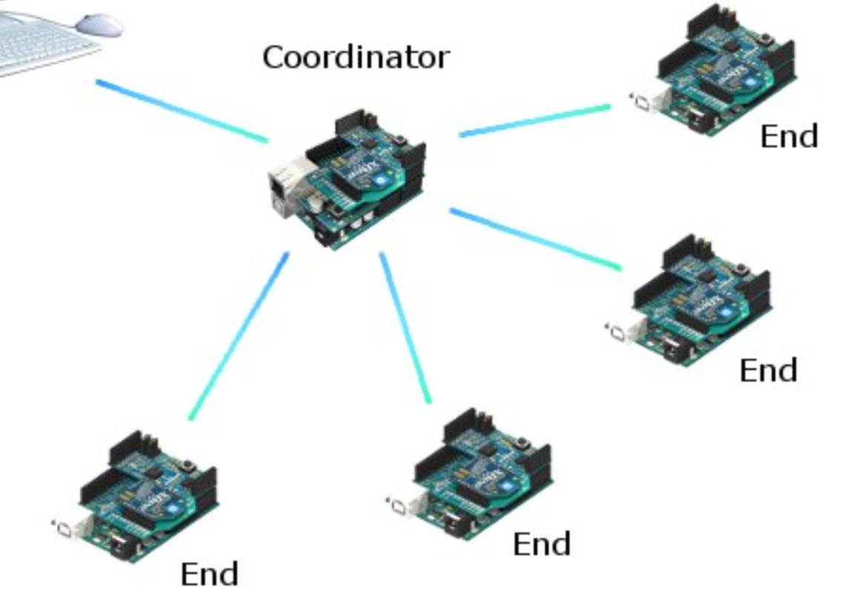
Architecture
Store data continuously
Retrieve historical data
Database
server
Send real/ historical data
Request real/historical data
Client

Slide 6
Javascript Library
canvas.js http://canvasjs.com
smoothie.js http://smoothiecharts.org
dygraph.js http://dygraphs.com
Database : MongoDB
collection{ (time, sensorID, temperature, unit),(…),(…),(...),(...)}
Visualize Raspberry Pi : RealVNC

Slide 7
Challenges Encountered and Resolved
Add and Drop Devices
Read Data from MongoDB
Web browser in raspberry Pi

